Slide 1
FIRE DETECTION USING DEEP LEARNING
SHIVAM PANDEY (2000270100148)
SURYAKANT PATEL (2000270100162)
VIPIN MAURYA (2000270100187)
SARAL MITTAL (2000270100135)
GUIDE
Dr. Shashank Sahu

Slide 2
Contents
Introduction
Outcome of Literature Survey
Design Details
Existing Approaches
Proposed Approach
Advantages of our Approach
Results
Conclusion

Slide 3
Introduction
PROBLEM:
India in 2015, 1,193 persons injured and 17,700 killed.
Third position in the National Risk Survey report.
Australian wildfires of 2019-2020 were the deadliest forest fires.
Half a billion animals killed, 20 million acres burnt, 100 billion $ in damages.
Could be prevented by deploying fire detection systems but the existing systems have lot of shortcomings

Slide 4
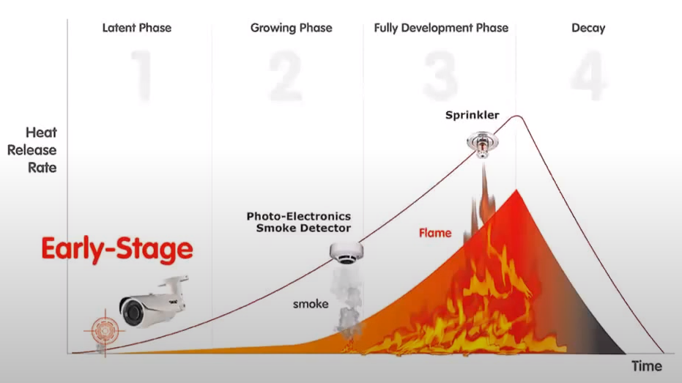
Introduction
In this work, we are building a deep learning model
to identify fires in images/video-frames
Deep learning is achieved through Transfer
learning.
The model can be used to detect fires in
surveillance videos.
Does not require special infrastructure for setup
nor does it need domain knowledge and
prohibitive computation for development.

Slide 5
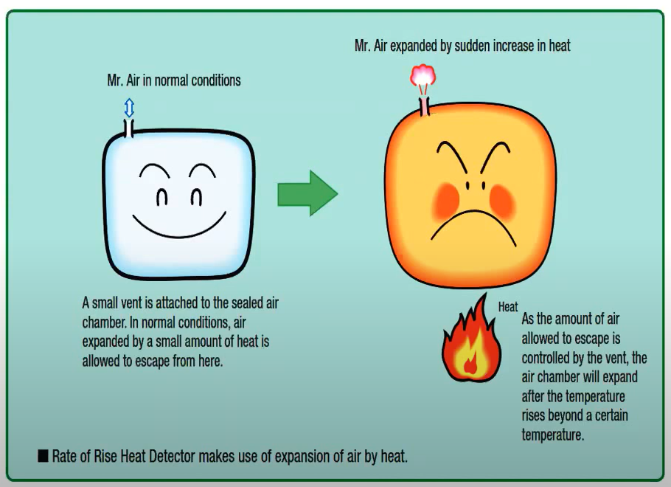
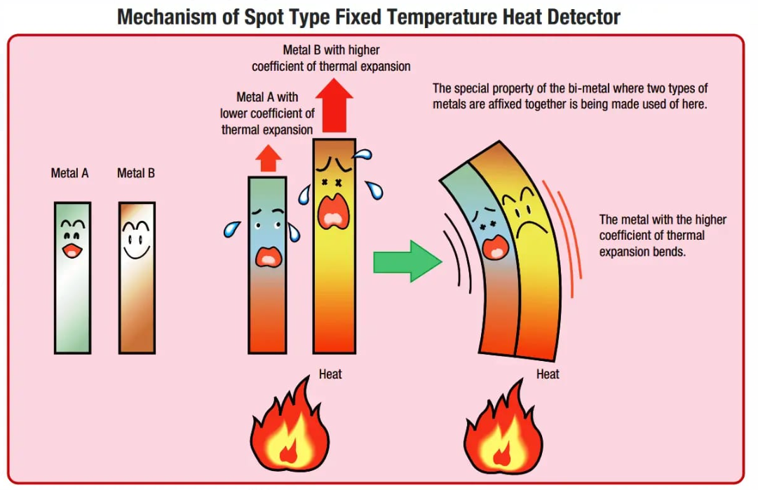
HEAT DETECTORS

Slide 6
Outcome of literary survey
Traditional Machine learning using feature engineering require
Immense domain knowledge
Tedious and time-consuming
Problem-dependent.
Design of a deep learning model from scratch requires ▪ Large Dataset Immense computational resources
Slow process
Difficult to tune hyper-parameters
Transfer learning is the best way to go!

Slide 7
Existing Approaches-HEAT DETECTORS
Heat detectors
Do not sense particles of combustion (smoke).
Designed to alarm only when heat on their sensors increase at a
predetermined rate or reaches a predetermined level.
Heat detectors are designed to protect property, not life.
Blockage of the heat flow to the detector due to objects.
Heat detectors are generally slower to detect fires.
Heat detectors cannot detect smolder fires which is leading cause of death in such accidents.

Slide 8
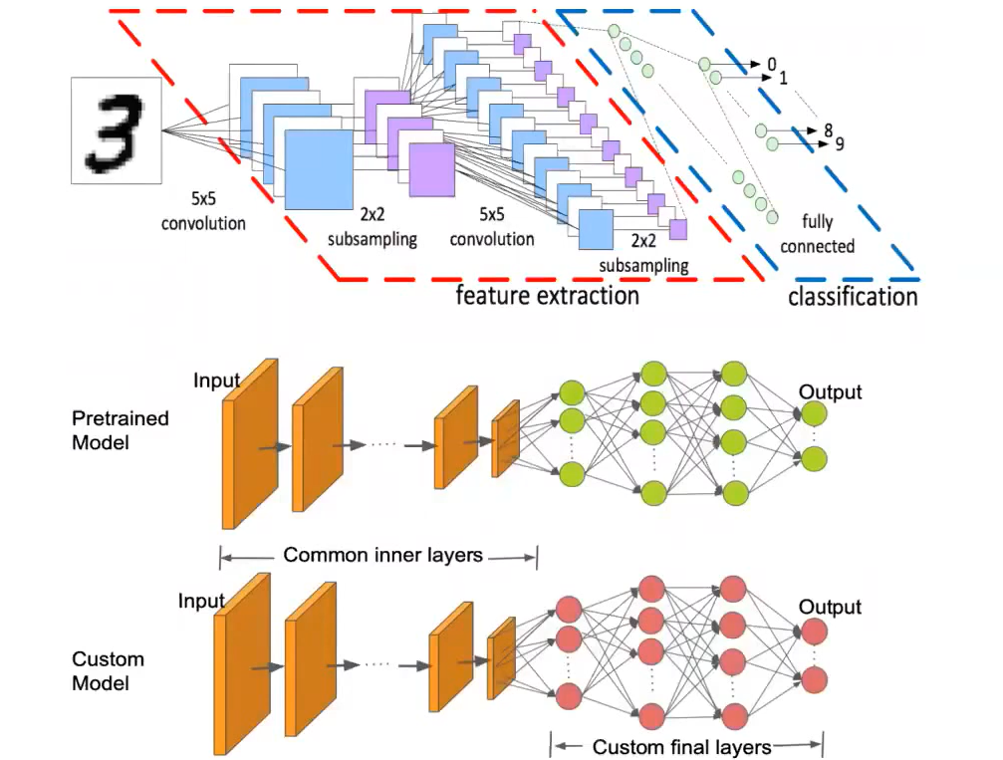
Proposed Approach
Transfer Learning is the reuse of a
pre-trained model on our
problem.
Pre-trained deep learning models
are used for feature extraction
The methodology is called
representation learning
Supervised ML classification
algorithms are used to classify the
extracted features

Slide 9
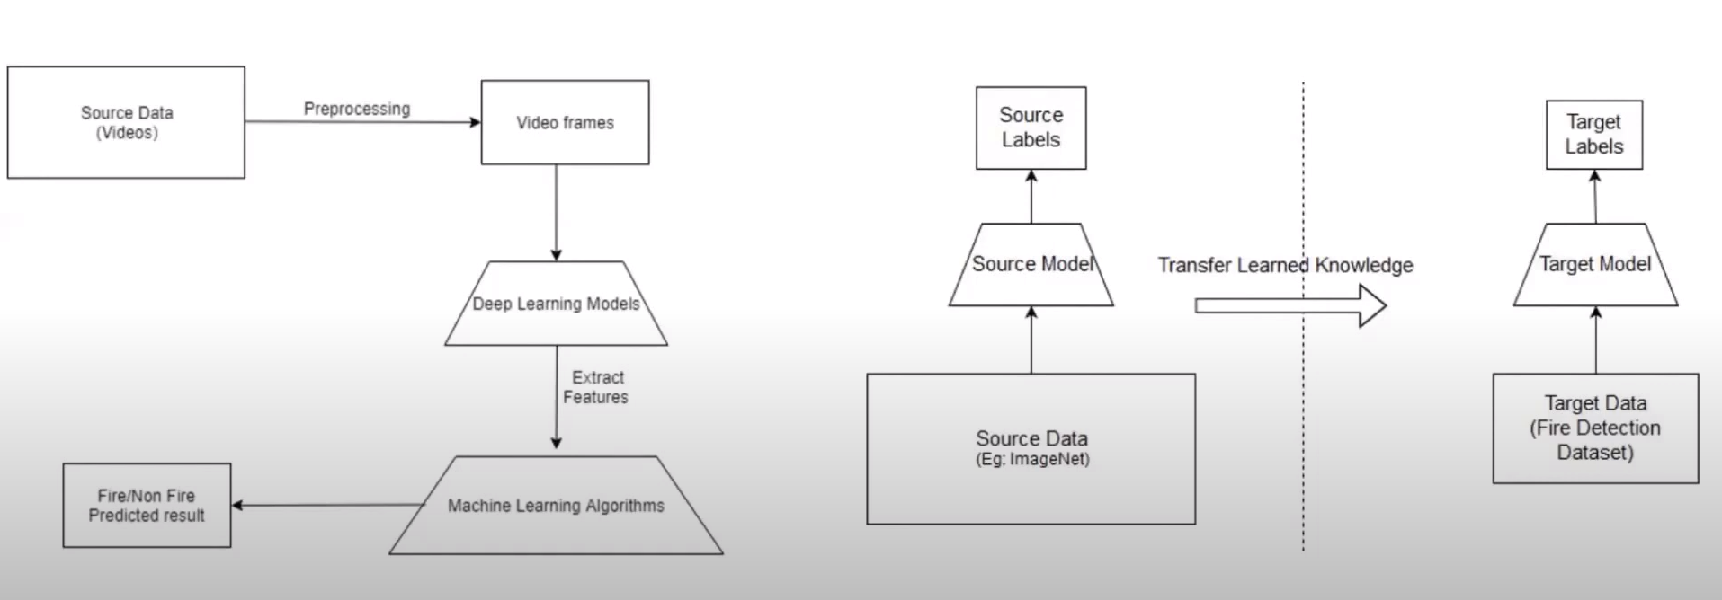
EXISTING APPROACH

Slide 10
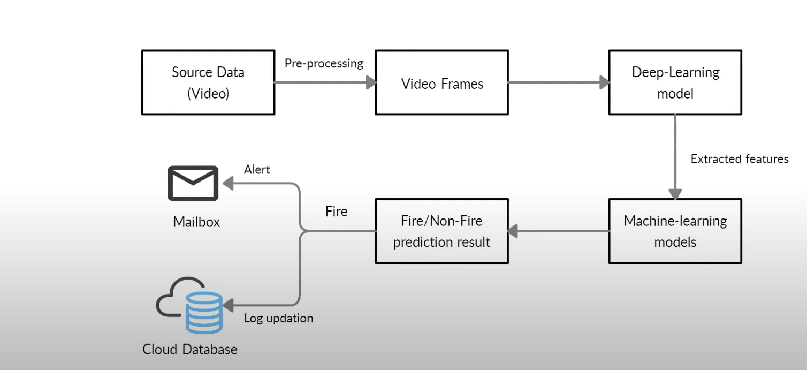
Proposed Approach

Slide 11
ADVANTAGES OF OUR APPROACH
Compared to existing hardware solutions, our application is
Accurate, affordable, robust, reliable.
No need of setting up a dedicated infrastructure.
Due to the use of deep learning and transfer learning techniques, our model
Easier to build, alter, upgrade, requires fewer computing resources to train.
No need for Domain Knowledge.
Minimized use of computing resources.
This application Is meant for detecting fires using visual input, and hence can be integrated with the existing
surveillance infrastructure.

Slide 12
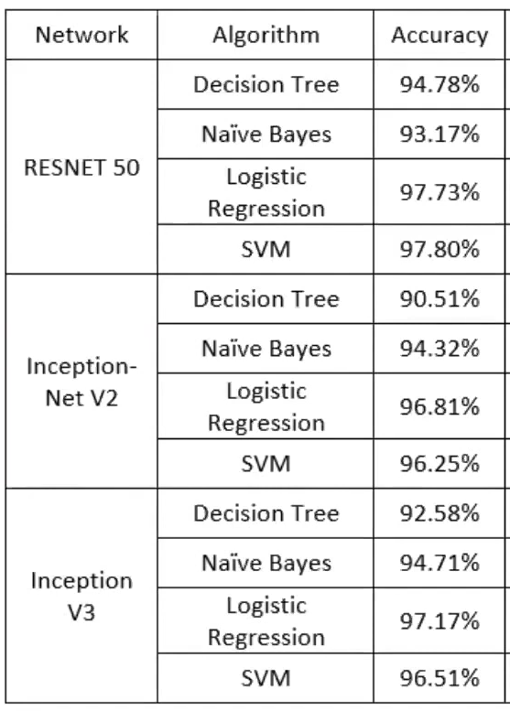
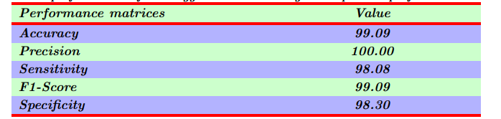
RESULTS
Experimenting different combinations
Performance metrics : Accuracy, Precision
and Recall.
Best combination :
RESNET 50 + Support Vector Machine

Slide 13
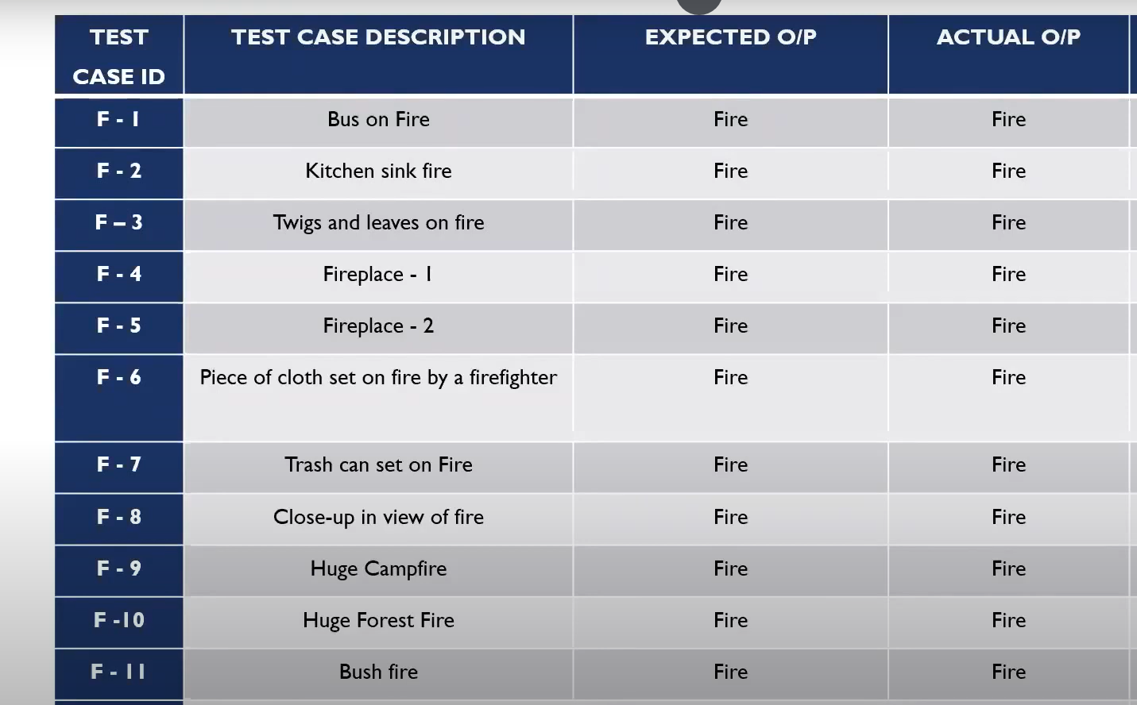

Slide 14
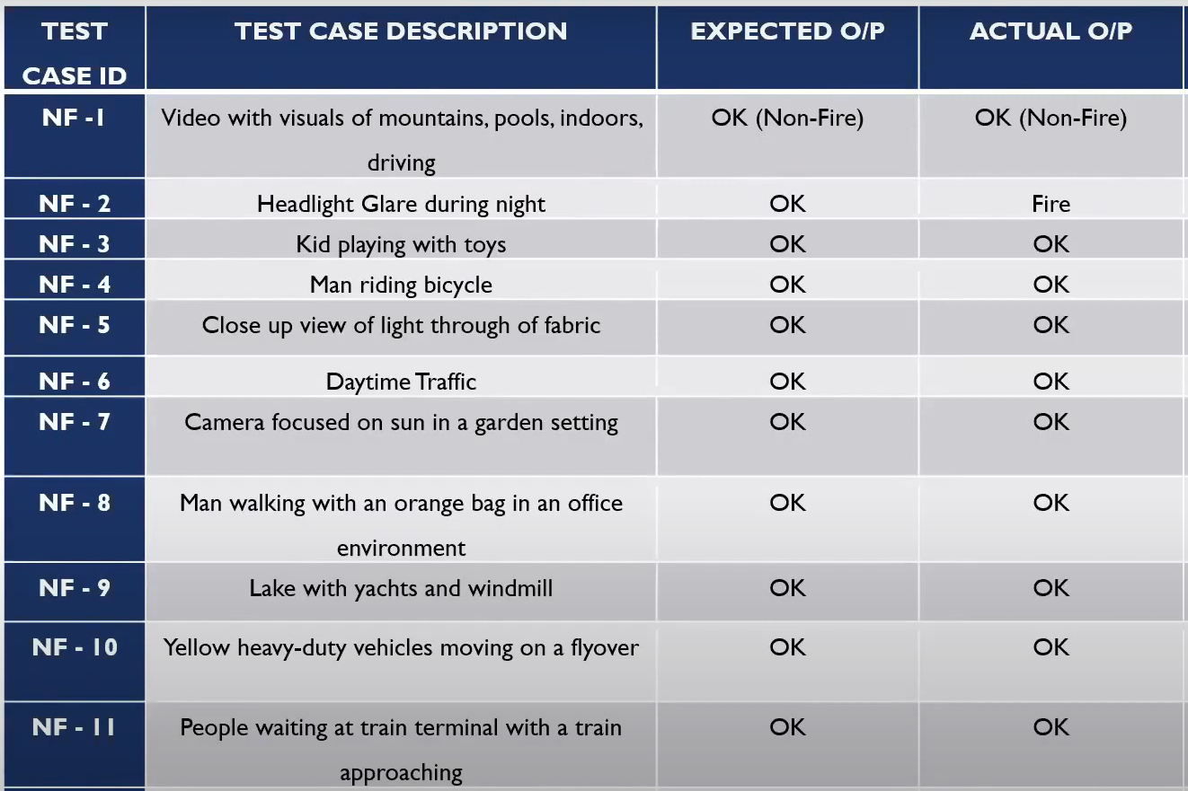

Slide 15
THANK YOU!!!

